Slide 1


ARKA EDUCATION & CULTURAL TRUST(R)
JAIN INSTITUTE OF TECHNOLOGY, DAVANAGERE
(A UNIT OF JAIN GROUP OF INSTITUTIONS, BENGALURU)
AFFILIATED TO VTU | APPROVED BY AICTE NEW DELHI AND GOVERNMENT OF KARNATAKA
DEPARTMENT OF COMPUTER SCIENCE AND ENGINEERING
Echo Eats: Voice-Based Food Ordering Web Application
INTERNSHIP ON:
PYTHON FULL STACK DEVELOPMENT
EXTERNAL GUIDE : Mr. GOVIND RAJ P
INTERNAL GUIDE : Ms. RAMYA BN
PRESENTED BY:
DHANUSH KUMAR PV
[4JD22CS032]

Slide 2

QSPIDERS (A Unit Test Yantra Software Solutions)
GLOBALLY RECOGNIZED
KEY HIGHLIGHTS
  Software training organization.
  Focused on industry-oriented technical education for students and professionals.
  Vision: To bridge the gap between academic learning and industry. requirements
  Strong placement support and career guidance.
  Hands-on training with real-world projects.
COURSE DETAILS
ACHIEVEMENTS
  Course: Python Full Stack Development.
  Location: Pyspiders, Rajajinagar, Bengaluru.
  4.78+ lakh Engineers have been placed through the company over the period of 12+ years.

Slide 3
INTERSHIP OBJECTIVES :
Giving complete knowledge of web applications. Covers both frontend and backend development.
Increases job opportunities in the IT industry.
Helps in building end-to-end projects independently.
Better understanding of system design and architecture.
Easier to switch between roles (Frontend / Backend / Developer).

Slide 4
PROJECT OBJECTIVES :
To develop a voice-based food ordering system using AI technology.
To create a web application using Django and React.
To implement speech recognition for user voice commands.
To facilitate secure online transactions using the Razorpay payment gateway.
To improve user experience with a simple and interactive interface

Slide 5
INTRODUCTION :
3-TIER ARCHITECTURE OF SOFTWARE STACK:
4
2
MIDDLEWARE
  HTML
  CSS
  BOOTSTRAP
  JAVA SCRIPT
  REACT JS
  DATABASE
  ORACLE SQL
  MYSQL
  POSTGRE SQL
  PYTHON
  DJANGO
  API
BACKEND
FRONTEND
1
3

Slide 6
SOFTWARE AND HARDWARE TOOLS :
SOFTWARE TOOLS:
Python IDE : For Python Programming.
Oracle Database (11g) : For SQL and Database Management System.
Web Browser : For accessing applications.
HARDWARE TOOLS:
Laptop / Computer.
Minimum 4GB RAM.
Internet Connection.

Slide 7
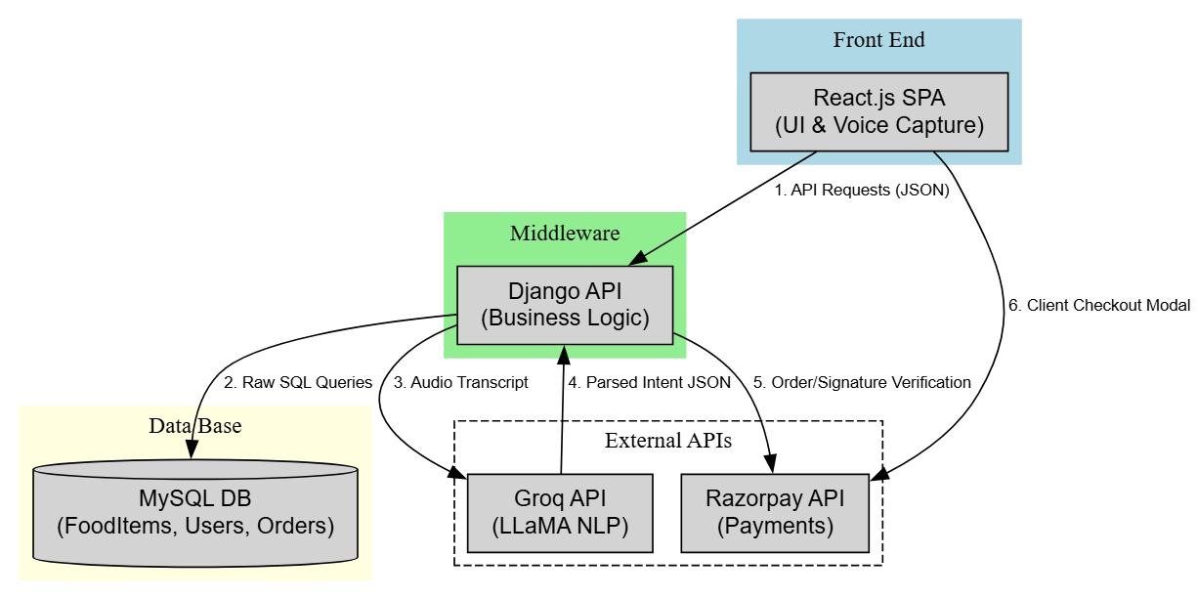
METHODOLOGY :

Slide 8
IMPLEMENTATION:
Setup of Django backend, React frontend, and database for the food ordering system.
Development of APIs for menu management, cart operations, and order processing.
Design of responsive frontend pages such as menu, cart, login, and checkout.
Integration of speech recognition for voice-based food search and ordering.
Testing, debugging, and final integration of frontend, backend, and voice assistant modules.

Slide 9
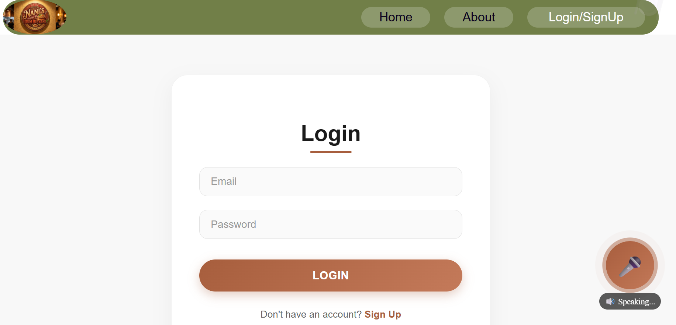
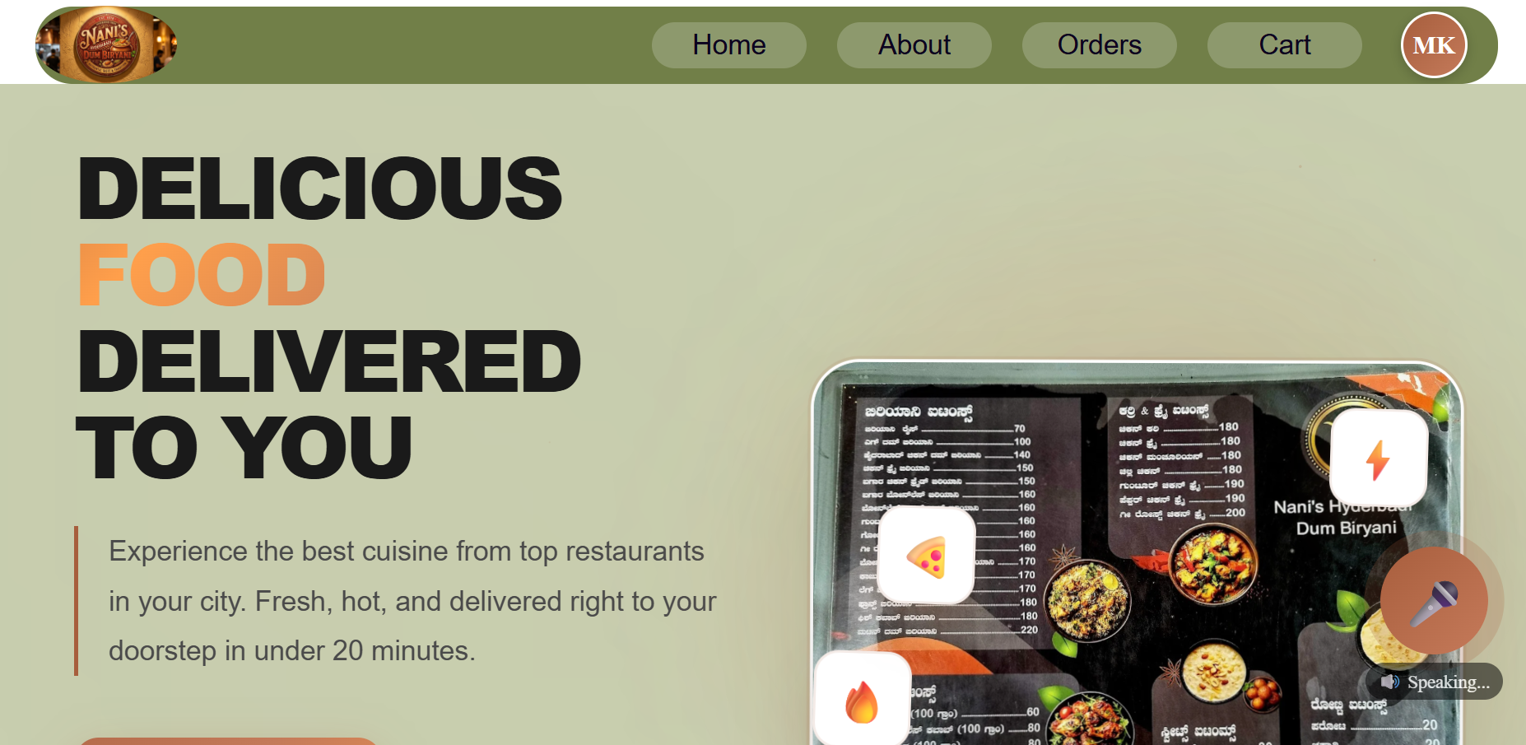
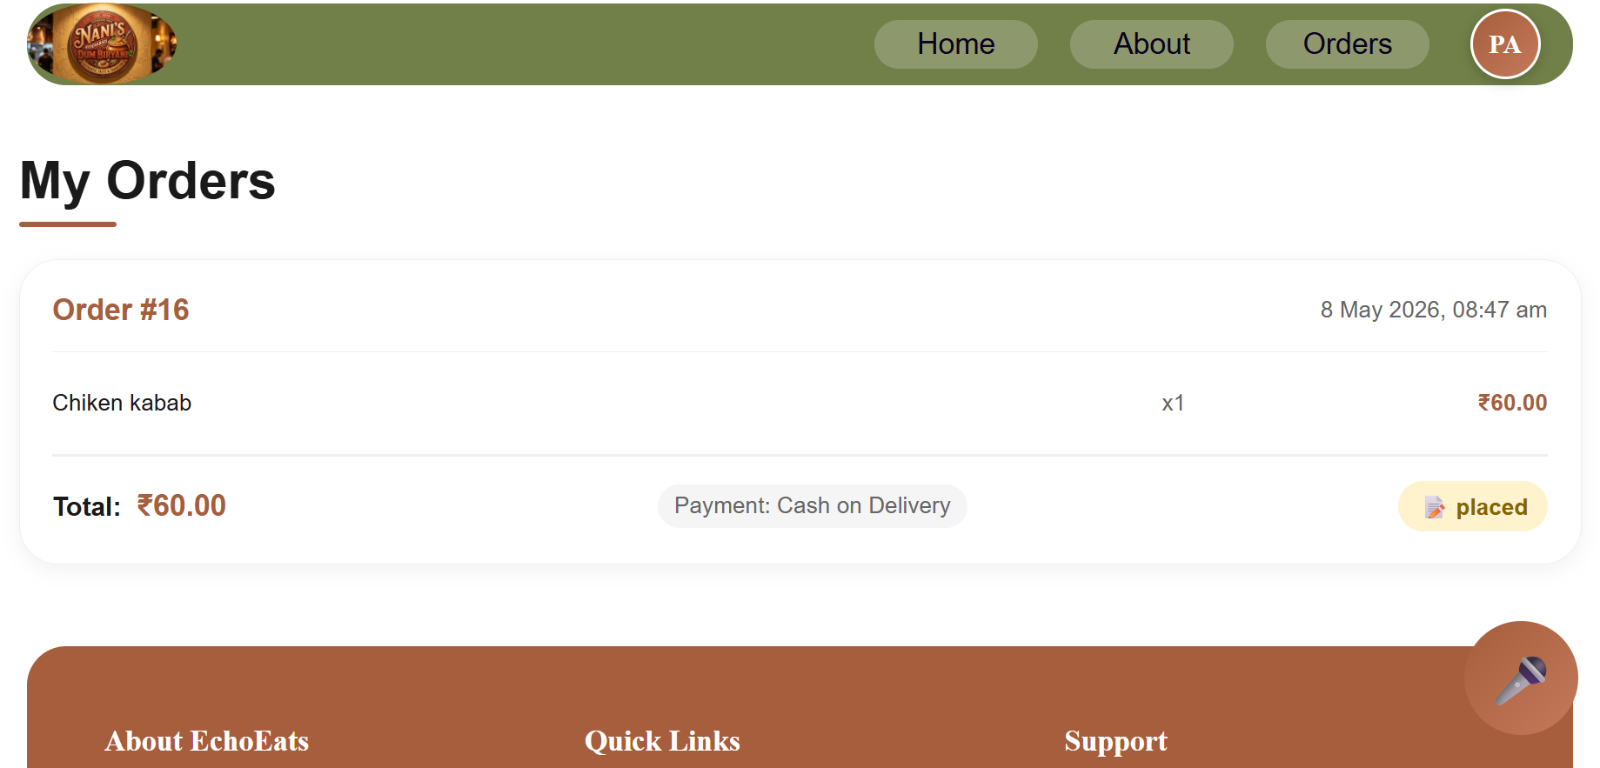
SNAPSHOTS:

Slide 10
CONCLUSION:
The Eco Eats Voice Assistant Project Was Successfully Developed Using Django And React Technologies.
The System Provides An Easy And Interactive Voice-Based Food Ordering Experience For Users.
Speech Recognition Integration Improved The Efficiency And Convenience Of Food Searching And Ordering.
The Project Helped In Gaining Practical Knowledge Of Full Stack Development And API Integration.
The Application Achieved Smooth Frontend-Backend Communication With Effective Cart And Checkout Functionality

Slide 11
THANK YOU

